Slide 1
Notes:
<numéro>

Slide 2
SQL Tuning made much easier with SQLTXPLAIN (SQLT)
Carlos Sierra Consulting Technical Advisor
Center of Expertise (CoE)
Notes:
<numéro>

Slide 3


Carlos Sierra
Oracle Server Technologies(ST) Center of Expertise(CoE)
SQL Tuner handyman: developer, advisor, trainer, support
IT: Oracle(17), UNISYS(12), Ford(3), others(3)
Florida(17), Venezuela(3), Puerto Rico(6), Michigan(1), Mexico(X)
Tools: SQLTXPLAIN(SQLT), SQLHC, TRCANLZR(TRCA), others
Motto: Life is good!
Notes:
<numéro>

Slide 4
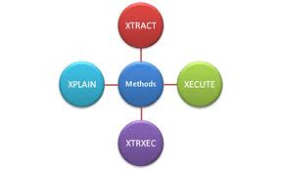
Agenda
SQL Tuning made much easier with SQLTXPLAIN (SQLT)
Introduction
Installation
Main methods
XTRACT, XECUTE and XTRXEC
XTRSBY and XPLAIN
XPREXT and XPREXC
Main HTML diagnostics report

Slide 5
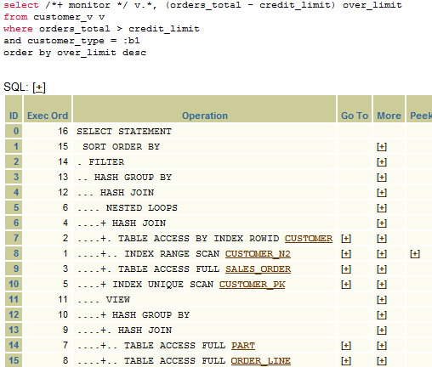
SQLTXPLAIN (SQLT) Introduction

Slide 6
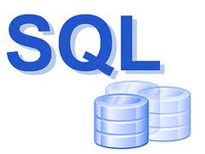


What is SQLTXPLAIN (SQLT)?
Tool to diagnose SQL statements performing poorly
Add-on (MOS 215187.1)
11g/10g
Linux, UNIX, Windows
Single instance, RAC, Exadata
Easy to install and execute
download and use

Slide 7


SQLTXPLAIN (SQLT) benefits
What is in it for me?
Collect SQL tuning diagnostics for one SQL statement
Over a hundred health-checks (HC) around the SQL statement
If Oracle Tuning or Diagnostics Pack are properly licensed
Invokes SQL Tuning Advisor (STA)
Includes Active Session History (ASH) and SQL Monitor Report
Includes Automatic Workload Repository (AWR)
Automatic SQL tuning test case (TC) extraction
SQLT helps to expedite SQL tuning process
Notes:
<numéro>

Slide 8

SQLTXPLAIN (SQLT) mechanics
How does it work?
3 + 4 main methods to analyze one SQL statement
Inputs one SQL statement and outputs one zip file
Output contains a main html report and other files
AWR, ADDM, ASH, 10053, 10046, TKPROF, etc.
Exports SQL tuning test cases
SQLT TC and TCX
11g Test Case Builder (TCB)
SQLT installs its own two schemas and objects on them!

Slide 9
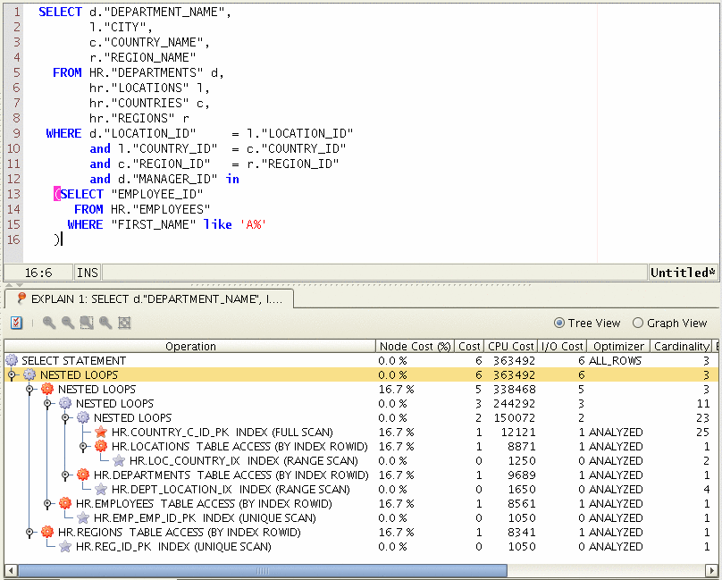
SQLT Installation

Slide 10

How do I install SQLT?
My Oracle Support (MOS) 215187.1
Download tool (sqlt.zip file)
Unzip into database server
Execute sqlt/install/sqcreate.sql connected as SYS
Input installation parameters

Slide 11


SQLT Installation Parameters
Provided inline or when asked
Optional Connect Identifier (ie: @PROD)
Password for user SQLTXPLAIN
Default Tablespace
Temporary Tablespace
Main application user of SQLT
Oracle Pack license [ T | D | N ]

Slide 12
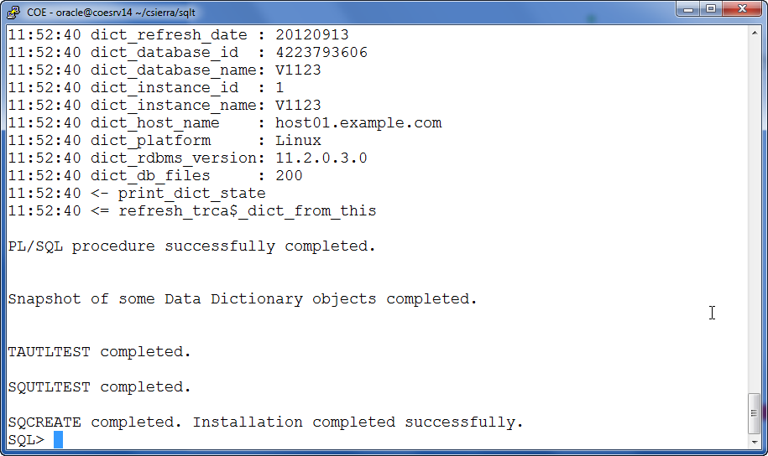
How do you know Installation succeeded?

Slide 13

How do I uninstall SQLT
In case you no longer need SQLT
Execute sqlt/install/sqdrop.sql connected as SYS

Slide 14
SQLT Main Methods

Slide 15

SQLT Main Methods
All 3 + 2 + 2 act on one SQL statement
SQLT XTRACT
SQLT XECUTE
SQLT XTRXEC
SQLT XPLAIN
SQLT XTRSBY
SQLT XPREXT
SQLT XPREXC

Slide 16
Using SQLT Main Methods

Slide 17

SQLT Output Overlap
XTRACT
XPLAIN
Common
XTRSBY
XECUTE
XTRXEC includes XTRACT and XECUTE

Slide 18
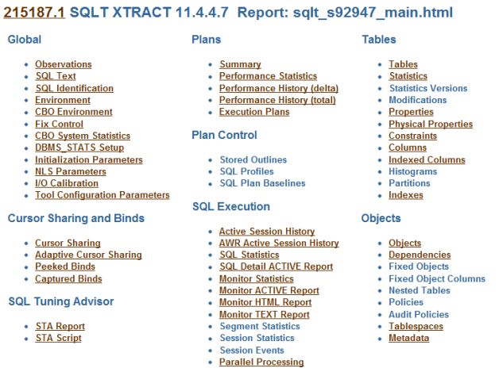
SQLT Main HTML Diagnostics Report

Slide 19

What is included in Main Report?
Partial list of contents (1/3)
Health-checks
SQL text
Parameters
Cursor sharing
SQL Tuning Advisor (STA) report
Execution plans

Slide 20

What is included in Main Report?
Partial list of contents (2/3)
Plan stability
Active Session History (ASH)
SQL performance metrics
SQL Monitor
Segment and session statistics
Tables

Slide 21

What is included in Main Report?
Partial list of contents (3/3)
Indexes
CBO statistics
Objects and dependencies
Policies
Metadata

Slide 22


Navigating the SQLT Main Report
Typical Navigation
SQL Text
Plans Summary
Observations
Branch as per findings

Slide 23

Demonstration
Main Report Navigation
SQLT XTRACT
SQLT XECUTE

Slide 24

Summary

Slide 25

SQL Tuning made easier with SQLTXPLAIN
How is that?
Full collection of SQL tuning diagnostics
Consolidated into an easy-to-navigate html report
Consistent view
Allow offline expert analysis
Over a hundred health-checks around the SQL statement
Some with pointers to particular notes or bugs
Automatic SQL tuning test case (TC) extraction
Allow WHAT-IF evaluations on a test environment
Dynamic readme with commands for further diagnostics

Slide 26
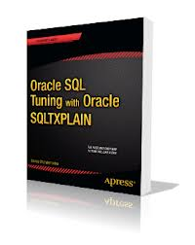
Want to master SQLTXPLAIN?
Book: Oracle SQL Tuning with Oracle SQLTXPLAIN
Author: Stelios Charalambides
Released: March 20, 2013
Level: Intermediate
Available
Apress
Amazon
Barnes&Noble

Slide 27

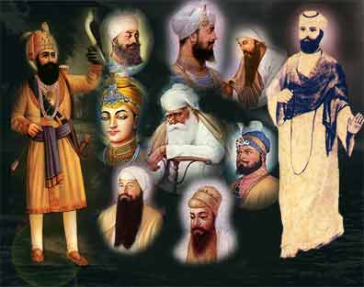
Eager to master SQL Tuning?
Some SQL Tuning Gurus (Google them!)
Jonathan Lewis
Maria Colgan
Tom Kyte
Wolfgang Breitling
Cary Millsap
Christian Antognini
Guy Harrison
Karen Morton

Slide 28

My Oracle Support Notes and Contact Info
MOS (Metalink) Notes
215187.1 SQLTXPLAIN (SQLT) Tool Download
1454160.1 SQLTXPLAIN (SQLT) FAQ
carlos.sierra@oracle.com
http://carlos-sierra.net
@csierra_usa

Slide 29
Notes:
<numéro>

